Slide 1
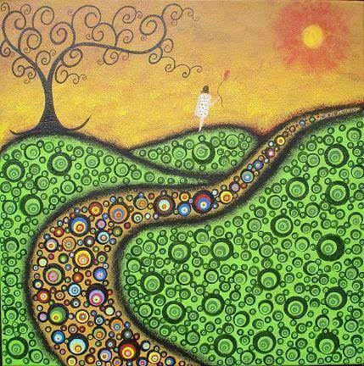
PILGRIMS OF THE GLOBAL COMPACT ON EDUCATION Methodology Guidelines
Ernesto Cavassa sj
Belén Romá

Slide 2
BUILDING TOGETHER
Building: It is a gift (we are heirs of a tradition) and a task (it’s up to us to reimagine it in every circumstance)
Together: Paul’s idea of the “body” where the body is one and the parts are many, each with it’s own function; these are the individual charisms of each one in the Church

Slide 3
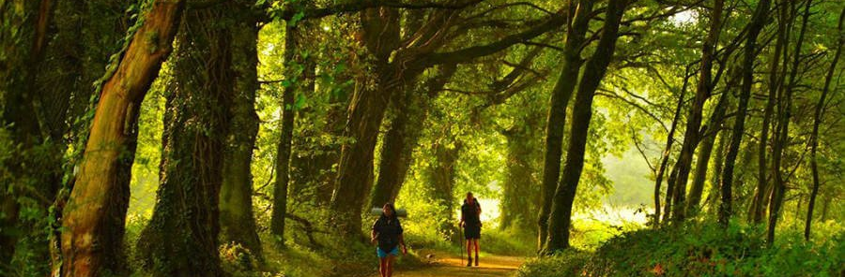
WALKING THE PATH
The path is revealed by walking it (Machado)
Exploring, experimenting… with our eyes on the horizon
The horizon: JM’s contribution to the Global Compact on Education (GEC)
How do we know which path leads us towards the horizon?

Slide 4
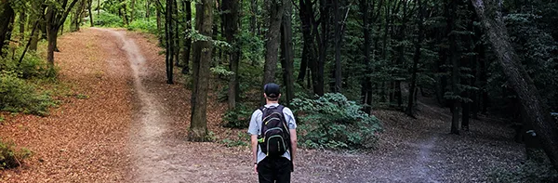
DISCERNING
Discern = distinguish, put order, prioritise
Process of awareness and listening (to reality, to others, to the poor, to myself)
“Letting go of self-love, self-will and self-interest” (Sp. Ex.) in order to build together JM’s contribution to the GEC

Slide 5
HOW WILL WE DO THIS? By different means

Slide 6
LET US RECALL THE OBJECTIVES OF THIS MEETING
To enable the lay people and religious who share mission to meet together.
To examine and explore Pope Francis’ proposal in the Global Education Compact in the light of the mission we share in JM and in line with the Preferences of the Congregation.
To agree our commitment as JM to the Global Education Compact (GEC).

Slide 7
PRAYER

Slide 8
PRESENTATIONS
They are not conferences, they are working points so that as a group we can bring together the fruits of our meeting

Slide 9
PERSONAL WORK Aimed at drawing up commitment to the GEC

Slide 10
GRUPOS Orientado a elaborar el compromiso para el pacto
GROUPS
Aimed at drawing up commitment to the GEC
SPIRITUAL CONVERSATION In order to discern the presence of the Spirit in each one of us through our conversations and to be open to the Spirit’s action

Slide 11
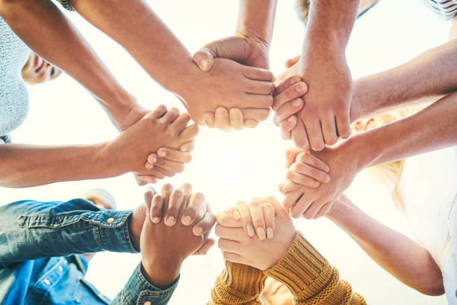
SUGGESTED TIMETABLE
Round 1: Each one shares
Each one shares the fruit of their personal work
Take 2-5 minutes to reflect quietly on all that you have listened to
Round 2: Spontaneous Dialogue
Those who wish to, share the fruits of this previous reflection
Open dialogue
Round 3: Conversation with the Lord
We pray aloud
We give you thanks Lord for…
Grant us light to discern what You are calling us towards…
Give us strength to follow the paths the Spirit reveals to us…
End: Summary and gathering of main message
PARTICIPANTS
We are all responsible
Share what you can and what you want, in a brief and clear manner
Attentive listening
It is not about solving individual problems
Respect what is confidential

Slide 12
TESTIMONIALS

Slide 13
PLENARY
SESSIONS

Slide 14
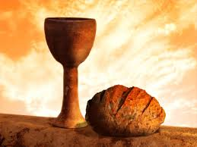
LITURGIES

Slide 15
MOMENTS OF MEETING AND SHARING

Slide 16
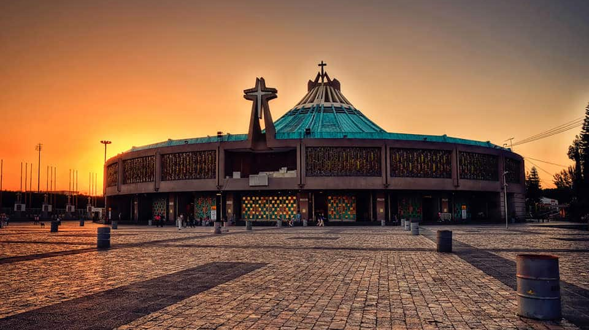
OUTINGS

Slide 17
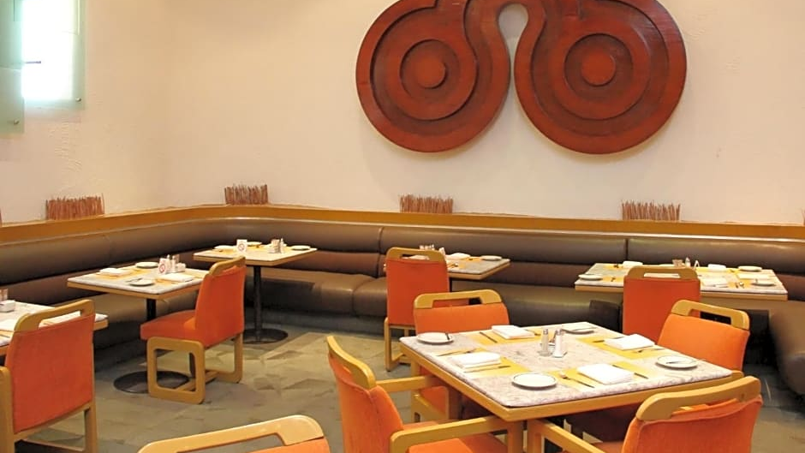
THE PLACE THAT WELCOMES US

Slide 18
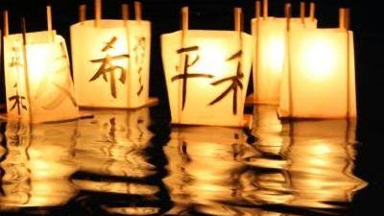
PRESENCE
LOOK, CONNECT, ENLIGHTEN

Slide 19
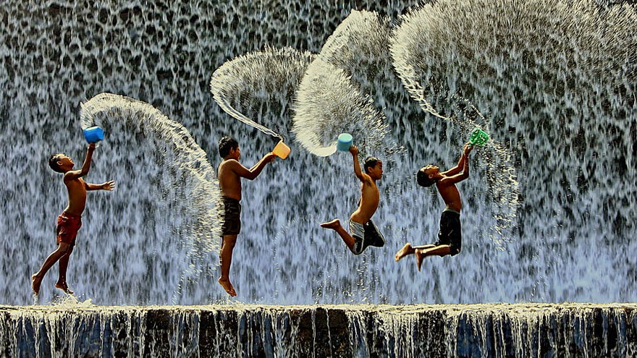
MYSTICAL EXPERIENCE
Surprising
Transformative
Generative

Slide 20
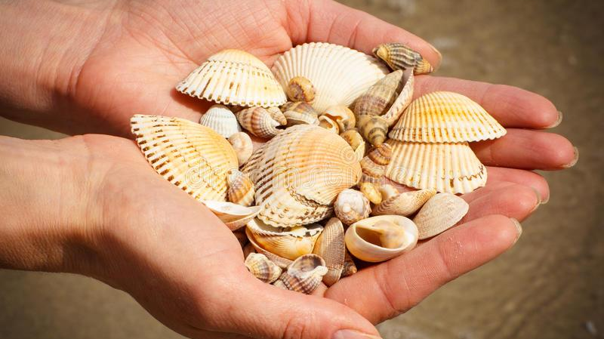
And God sustains us on our pilgrimage

